Slide 1


HKUST MBA FinTech Club
Blockchain Technology Primer
Blockchain Applications in FinTech
December 6th 2018

Slide 2
Agenda
Blockchain Technology Primer – Phillip Bonarigo
Business Applications of Blockchain & Cryptocurrency – Julien Hamonic
FinTech Week in HK – Puranjay Mahapatra
Demo of fiat/crypto, exchange, and dApp use – Phillip Bonarigo
Food, Drink, Networking, Q&A – HKUST MBA FinTech Club

Slide 3
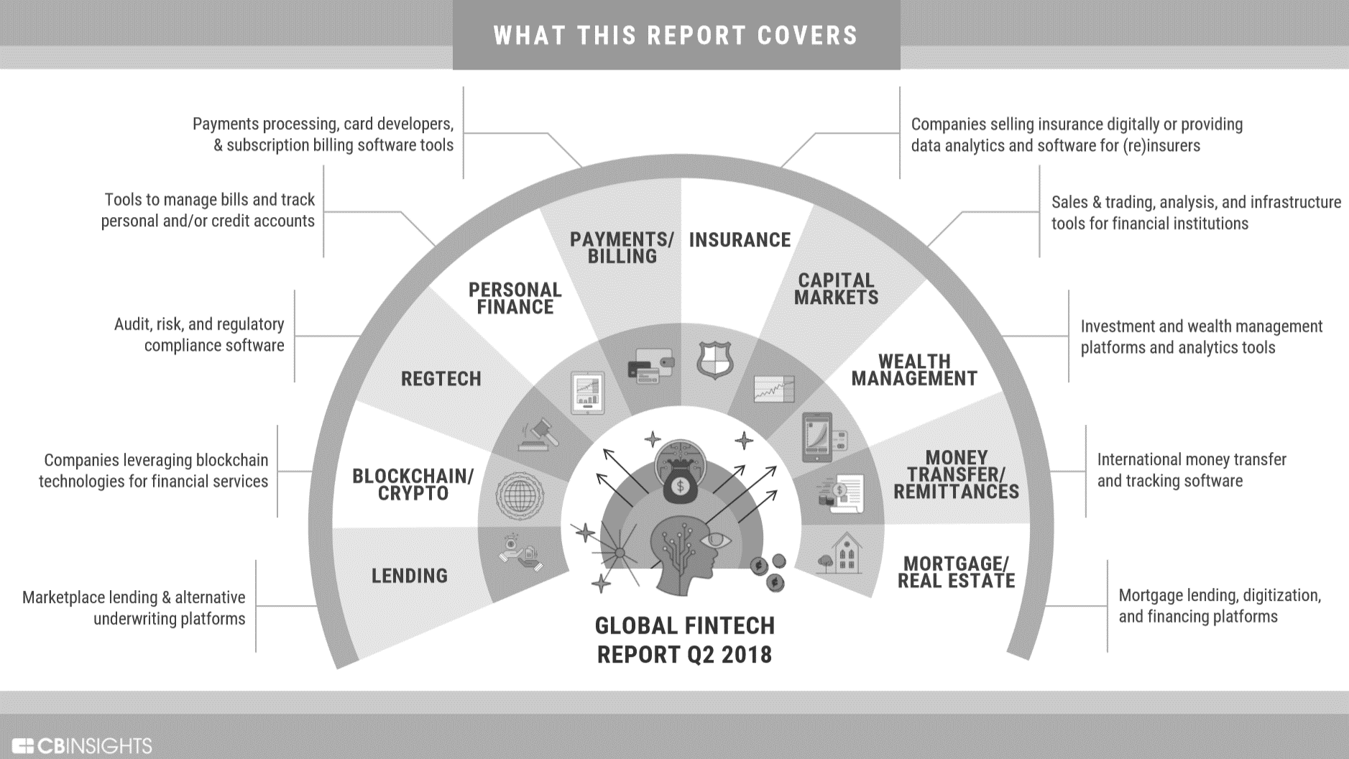

What will we be covering?
Blockchain Applications in FinTech – how does blockchain technology work, why is it important, and how can it be applied?
Our goal is to help you understand this technology a little bit better, but we won’t cover all the technical details.
This is a growing and changing space, so we’ll try to give a few examples, but many products and features are only now being tested – it is still early!

Slide 4
What is Blockchain?
A blockchain is a digital mechanism
in the form of a cryptographically-secure and publicly distributed ledger
The blockchain cannot be changed (immutable) once the ledger is updated
Otherwise, all subsequent entries are considered invalid.
A popular comparison is that blockchain is a Spreadsheet that anyone can access.
Every participant involved in making changes has a copy of the spreadsheet and is responsible for keeping it updated and accurate.
This results in an environment that requires trust.

Slide 5
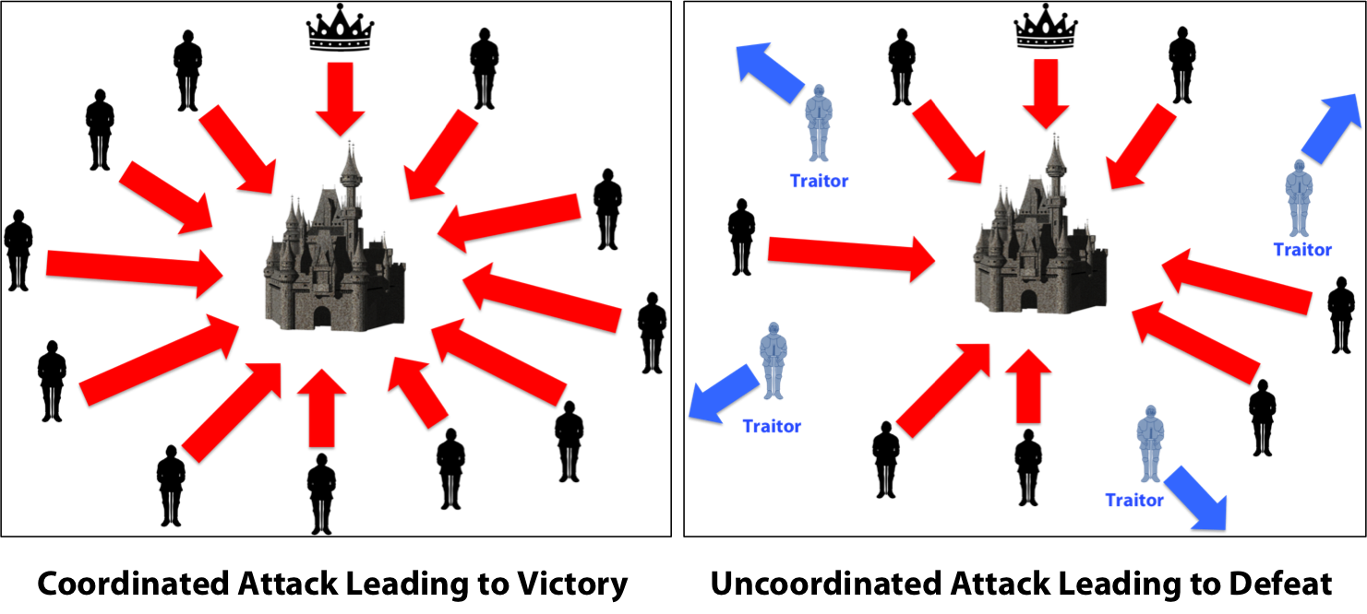
A real-world example is the Byzantine General’s Problem
Attackers = Nodes
Successful Attack = New Block
The concept of coordination and agreement is key to understanding blockchain technology. Some participants may not be “good actors” but we still want to ensure victory.

Slide 6
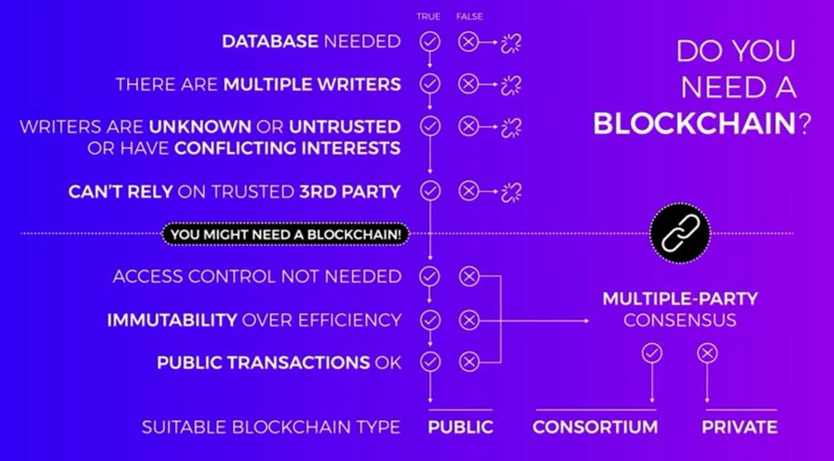
But wait a second…do I really need this?
Use cases for a blockchain
From ConsenSys Academy Coursera Course found here

Slide 7

An example of consensus mechanisms is proof of work
Aside on Consensus Mechanisms: Proof-of-Work
Proof-of-Work is the method that Bitcoin uses to confirm transactions to be added to the blockchain. This allows each miner to determine which set of blocks is the one true Blockchain.
It involves the entire group of computers on the Bitcoin network working together to partially decrypt a SHA256 Hash Function.
Bitcoin Miners must guess the hash output from a “nonce” that is used to combine with the block in order to return a hash function with a predetermined amount of leading zeros. As the number of mined bitcoins increases over time, the required number of leading zeroes goes up, effectively increasing the difficulty of producing new blocks.
Producing a block can take trillions of attempts and consumes a great deal of power. This method of consensus is incredibly secure, because the Blockchain that is regarded as correct is that which has the most CPU-cycles. But, as you can imagine, this is not the most ”green” method for consensus. There are many other consensus mechanisms that consume less power.
Once consensus is reached and the puzzle is solved (takes a few seconds to 10 minutes depending on the consensus mechanism) the new block is considered “mined” and added to the Blockchain
The entire Blockchain is simultaneously updated across the world, in all nodes (computers) running the Bitcoin Core client
The current reward for successfully producing a new block is 12.5 BTC (about $50K) and will halve every 210,000 until all 21,000,000 Bitcoin are mined, around year 2140 at current production rates and mining difficulty.

Slide 8
Important concepts in blockchain: hashing and hexadecimal numbers
Hex – base 16 (10+6 letters)
Compare to
Base 10 (typical numbering system)
Base 2 (binary)
Any data type can be hashed into the blockchain, with the same 64 character (256 bits in Hex system) output, each time – with 2^256 number of combinations – a huge number!
This enables a LOT of interesting possibilities, when you consider moving these values back-and-forth, and setting permissions for encrypting or decrypting them
Hash Example – Real Time

Slide 9
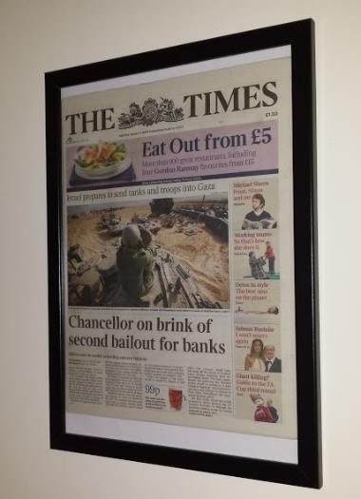
What is Bitcoin and what is its relationship to the Blockchain?
Bitcoin is one application of Blockchain technology. If we look at the internet today, most of the things we use it for are sharing photos, videos, emails, documents.
In these cases, we are sharing digital copies of items. If I send you a photo, I am sending you a copy of the photo; I still retain the original.
With finances and money, it would be bad if I still retained the money I was supposed to send you (known as the double spend problem).
Bitcoin uses a Blockchain to create a digital asset that can be owned. Bitcoin’s source code limits the amount in existence, creating a limited supply, and a Blockchain ledger records the possession of Bitcoin as it flows through the ecosystem.
000000000019d6689c085ae165831e934ff763ae46a2a6c172b3f1b60a8ce26f
The hash of the genesis block for the bitcoin coinbase.
The hash contains the data “The Times 03/Jan/2009 Chancellor on brink of second bailout for banks“
Hashes use the hex system for algorithmic processing, so there are letters and numbers present – this is complicated but is similar to how passwords are stored
Notes:
https://en.bitcoin.it/wiki/Genesis_block

Slide 10
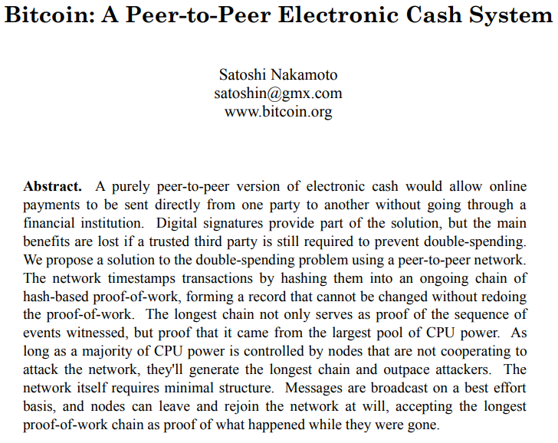
The First (of many) Whitepapers
Bitcoin Whitepaper
https://bitcoin.org/bitcoin.pdf

Slide 11
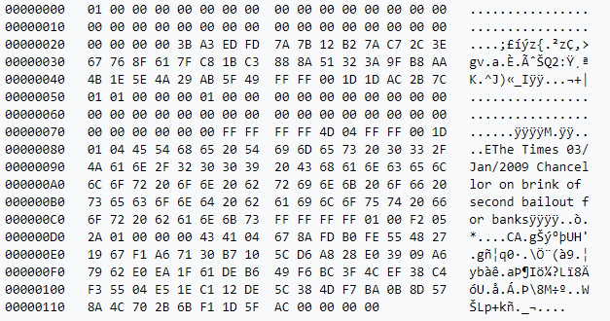
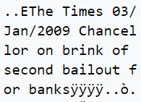
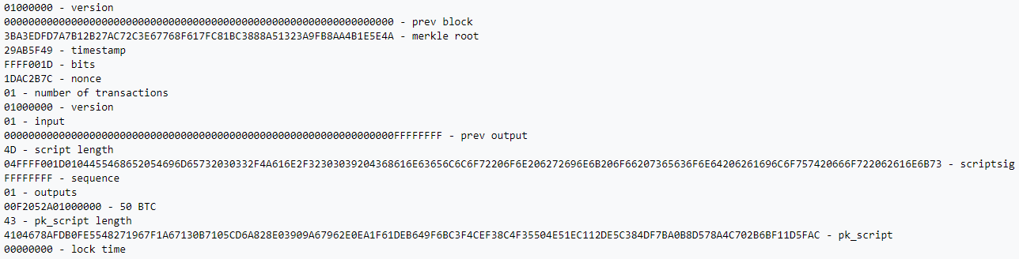
Example raw hexadecimal output of bitcoin genesis block – don’t worry about all the detail

Slide 12





A Financial Transaction Today
Today, when we send money, it goes through a Trusted Third Party, or intermediary
-$$$ Fee
Multi-day Processing Time
The transaction is recorded on a private ledger
(Bank Ledger)
We send money
Money is Received

Slide 13







A Financial Transaction on the Bitcoin Network
There is no intermediary with Bitcoin, only the other participants in the Blockchain network
Transaction is Validated by computers on the network (miners)
A consensus mechanism is executed to validate the entire ledger and the ledger is updated across the world
Send Bitcoin
Transactions are added to a public ledger
Bitcoin is Received
*There were 10,000 – 12,000 nodes (miners) running the Bitcoin core client earlier this year, according to Bitnodes
*Bitcoin uses the Proof of Work consensus mechanism, there are many different types

Slide 14
Properties of Bitcoin (and Most Other Cryptocurrencies):
*Properties of the underlying technology of Blockchain
Anyone can send and receive, anywhere in the world
Transactions only take a few minutes
Transaction fees are low
User information is private
Fraudulent transactions cannot happen
Transaction records can never be falsified or altered
—Anyone can create a wallet
—Peer-to-peer decentralized network
—No profit-seeking centralized Intermediaries
—Encrypted User Information
—Cryptographic Validation of Transactions
—Append Only Consensus Ledger
This creates a trusted financial system in a trustless economy

Slide 15




Two groups in the Bitcoin ecosystem
Miners
Senders / Receivers
(The users of Bitcoin)
(Provide the service of validation and receives bitcoin as payment)
Notes:
People who use bitcoin
People who validate the transactions

Slide 16

How a Bitcoin Transaction Works in More Detail
“I want to get into Bitcoin”
Public Key
“123BOB”
Makes a Bitcoin Wallet
*Cryptographic keys
WALLET
Private Key
This can be done online, or even offline with a downloaded program
“456SecretlyBOB”
Bob
*Cryptographic keys
Kind of like the door lock to your house, anyone can see your lock, but no one but you has the key

Slide 17




A TRANSACTION
Message:
“Send 5 BTC to 123Bob”
Proof I have bitcoins:
Alice
A list of all of the previous transactions where I received bitcoin (similar to an account balance)
5 BTC
Signature:
123SignedByAlice
This transaction is broadcasted to the entire network
The signature is a cryptographic function that is the result of Alice’s Private Key + The Unique Transaction Message. Miners can use this signature + Alice’s Public Key to validate that the message came from Alice’s Private Key, but there is no way to actually derive her private key from the signature.
Bob

Slide 18
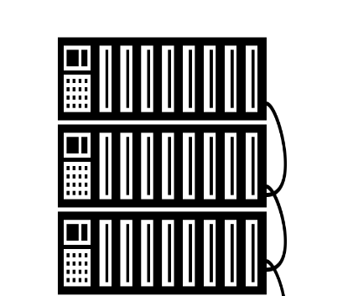



VERIFY
BLOCK
PROOF-OF-WORK
Miners then verify that Alice has the amount of bitcoin she claims to have, and that the message is signed by Alice
A stack of verified transactions is grouped together to form a block
For each block, all the computers in the network collectively compete to solve a complex math puzzle (The Proof of Work Consensus Mechanism) in order to collectively reach consensus on whether that block should be added

Slide 19

All this produces a very secure network! In Order to Hack this Blockchain and change it, You Would Need To…
…Hack every preceding block (the entire history of commerce)
…On millions of computers around the world simultaneously
…That all use the highest level of encryption
…And doing it in a race to beat the most powerful network of computing power in history
Pretty Secure!!
Notes:
visa - network to hack

Slide 20
Other Blockchain Examples

Slide 21
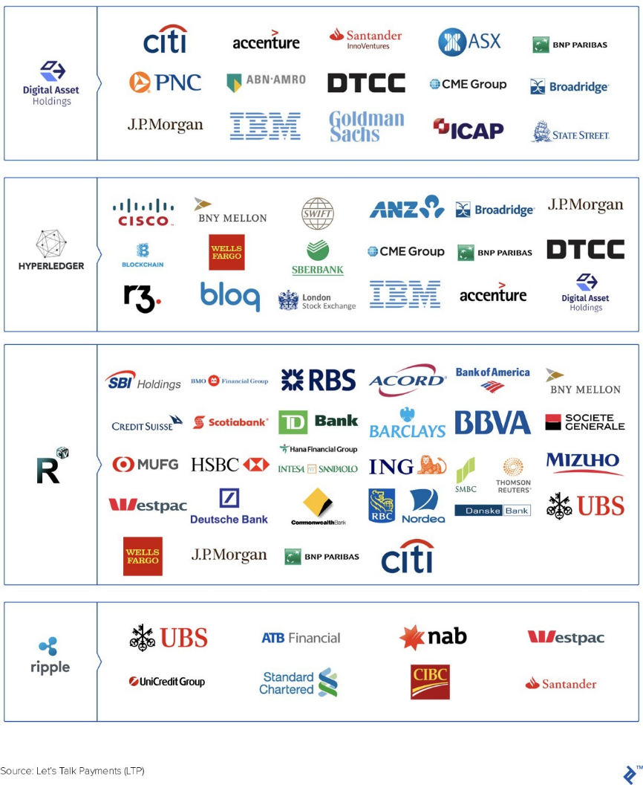






Blockchain Applications and Examples in Legacy Enterprise
The Linux Foundation – IBM Hyperledger Fabric
Oracle – Blockchain Group
Microsoft – Azure services
Amazon – AWS, QRDL
R3 – Corda for banking consortium

Slide 22
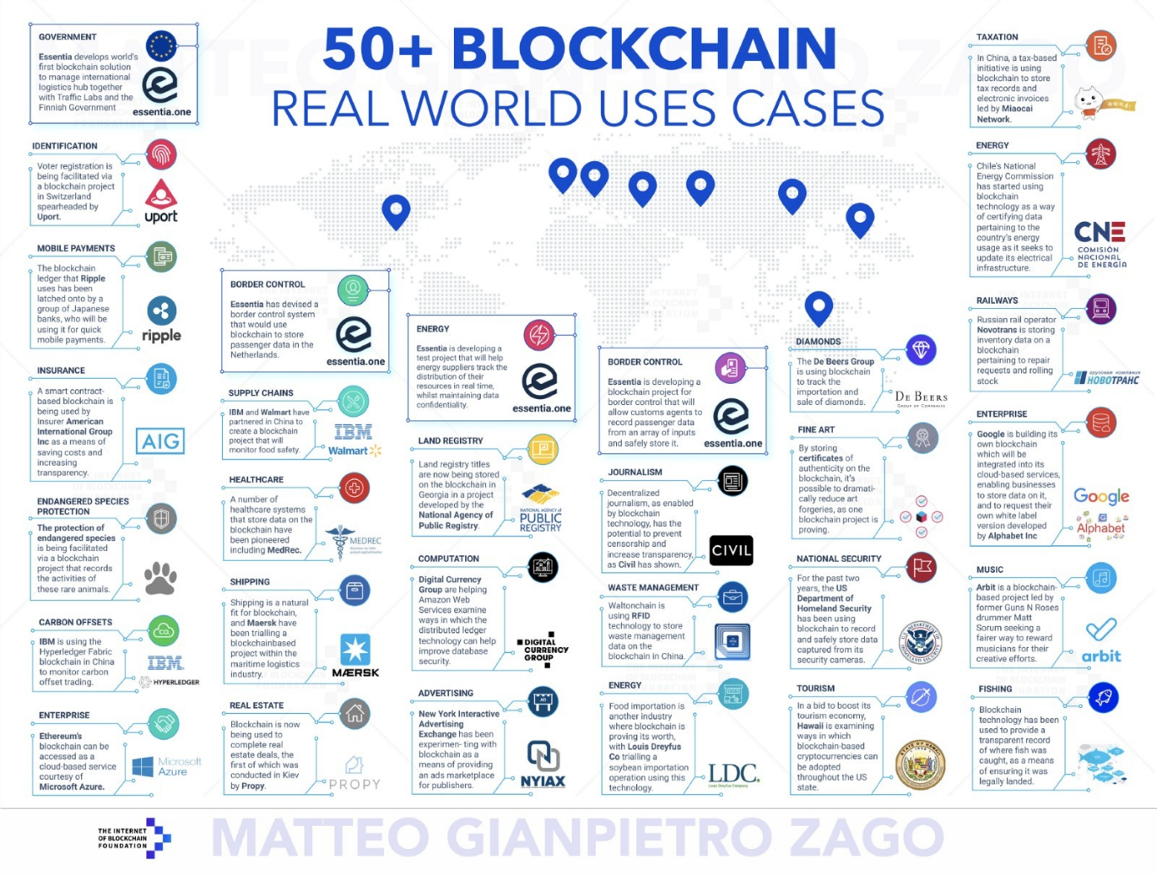
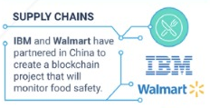
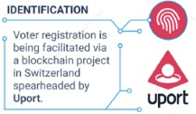
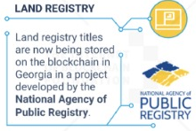
Select Blockchain Applications in Business

Slide 23
Q&A

Slide 24
Business Applications of Blockchain & Cryptocurrency
Initial Coins Offering:
a strategic perspective

Slide 25
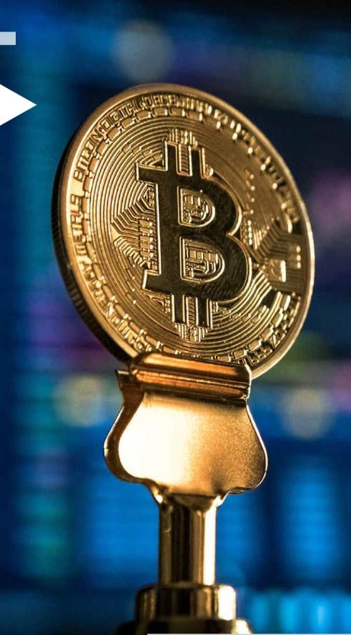
Initial Coins Offering: a strategic perspective
Characteristics of ICO / Token sales
An Initial Coin Offering (ICO) also known as a token sale or coin sale, is an “unregulated mean of crowdfunding via the use of cryptocurrency, which can be a source of capital for start-up companies” according to Wikipedia
In practice ICO are mainly a tool use in order to raise money to fund the R&D of a particular blockchain-related project
In the first three months of 2018, Initial Coin Offerings (ICOs) raised more money than the whole of 2017
In the first 5 months of 2018, a total of 537 ICO’s with a volume of USD 13.7 billion have been closed successfully – which is more than all pre-2018 ICOs combined
This is 45% of IPO volume in USD, for the same year
Special mention is made of the ICOs of Telegram and EOS, which reached into the billions: Telegram raised $1.7 billion through its ICO, while EOS raised over twice as much at $4.1 billion
According to PWC ICO report, the Cayman Islands, the British Virgin Islands and Singapore are now the 3 most important ICO hubs worldwide
China and South Korea have banned ICO and cryptocurrency exchanges

Slide 26
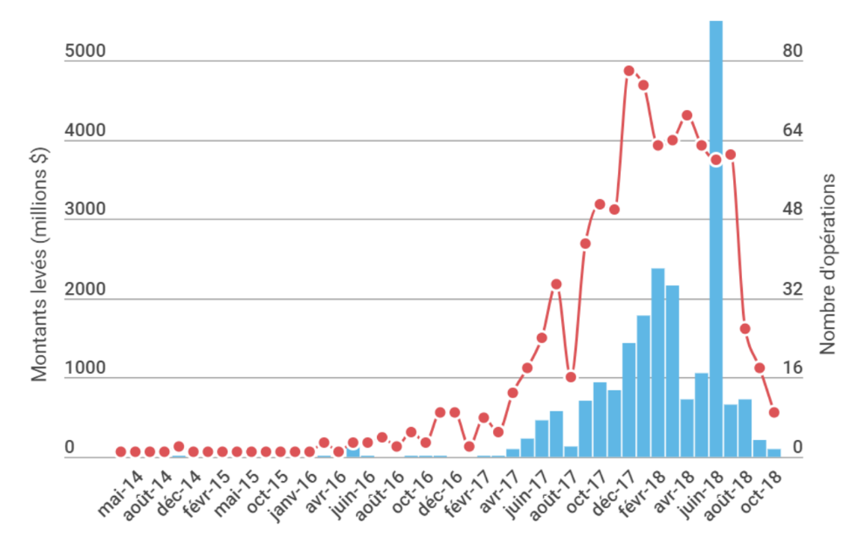
Initial Coins Offering: a strategic perspective
ICO market overview
FUNDS COLLECTED AND NUMBER
OF COMPLETED ICO PROJECTS
However, during the last quarter of 2018, the phenomenon of Initial Coin Offerings (ICOs) has seen a big dip, following the trend of the global bear crypto market
Prospectively, ICOs are increasingly an alternative to classic debt/ capital-funding as performed today by Venture Capital/ Private Equity firms and banks
Source: ICO Rating

Slide 27
Initial Coins Offering: a strategic perspective
ICO market overview
Top 10 ICOs by amount raised, 2018
Position | Project | Closing date | Total Raised (USD mn) | Country
1 | EOS | 06.2018 | 4,100.0 | Cayman Isl.
2 | Telegram | 03.2018 | 1,700.0 | BVI
3 | Dragon | 03.2018 | 320.0 | BVI
4 | Huobi | 03.2018 | 300.0 | Singapore
5 | HDAC | 02.2018 | 258.0 | Switzerland
6 | Filecoin | 12.2017 | 257.0 | USA
7 | Tezos | 09.2017 | 232.0 | Switzerland
8 | Sirin Labs | 07.2017 | 157.9 | Switzerland
9 | Bancor | 12.2017 | 153.0 | Switzerland
10 | Bankera | 06.2017 | 150.9 | Lithuania
Since November 2017 several large scale ICOs have entered the Top 15, dwarfing previous records from 2017
With Telegram (USD 1.7 bn) and EOS (USD 4.1 bn), the first true ICO Unicorns have appeared

Slide 28
Initial Coins Offering: legal considerations
The importance of the jurisdiction of incorporation
Top 10 countries per ICO amount
(as of September 2018)
Where should the offering/generating entity be established and do any other laws apply?
A number of token offerings to date have involved an entity incorporated or established in the Cayman Islands, Gibraltar, Singapore, Switzerland, the UK or the US.
There are many factors that drive the choice of jurisdiction, which vary on a case-by-case basis.
Main Factor: tax considerations
Singapore: corporate tax of 22% / BVI or Cayman: 0%
When the ICO raises more the 100MUSD, the difference is pretty substantial….(like OOway or VIVO)
Cayman Islands
ICO: 10
$4,254M
British Virgin
Islands
ICO: 16
$2,227M
Singapore
ICO: 53
$1,192M
UK
ICO: 48
$507M
Estonia
ICO: 31
$323M
Lithuania
ICO: 6
$259M
Israel
ICO: 5
$226M
USA
ICO: 56
$1,092M
Switzerland
ICO: 28
$456M
Hong Kong
ICO: 20
$223M
Source: PWC

Slide 29

Initial Coins Offering: legal considerations
Legal corporate structure of token sales
A typical ICO structure entails that the Issuer be set up as a shell structure (the “Issuing entity”), which is usually done in the form of a foundation, or a company limited by shares or by guarantee (as an example in Switzerland, Singapore, or in the BVI).
This entity is usually designed to carry out certain non-profit or profit making activities
In the case of public blockchains (BTC, ETH, etc), those activities have some basis of public interest, and the structure is most if the time a foundation
For example in cases where the intention is to create a Blockchain ecosystem serving the greater good, it may (also for marketing purposes) be useful to follow the tried and tested “foundation model” – also originally driven by tax considerations in Switzerland.
But in the major part of more recent ICO are launched by (existing and) for profit companies issuing utility coins for a Blockchain platform/solution: for those operations, a « classic » foundation is no more adapted
The actual platform providing the activities (the "Operating Company") is usually a separate legal entity, and segregates the operational, financial and legal risk of the Operating Company from the Issuer.
The Operating Company is generally structured as a private limited company which will also be responsible for the on-boarding of the users and the development and operation of the platform.
In this setup, the Issuer and Operating Company typically enter into a software development and a services agreement with each other.
Basically, the Issuing entity is focus on the ICO investors, and the Operating entity is focus on the blockchain plateform clients/users
Simplified structures involving only one legal entity are possible, but are not adapted for managing large fundraising amounts coming from multiple jurisdictions

Slide 30
Initial Coins Offering: legal considerations
Legal corporate structure of token sales
ICO corporate aspects
Management
Shareholders/
Guarantors
Investors
Determination of the type of corporate vehicle for the issuance entity
Creation and incorporation of the issuance entity (notably drafting of the articles of association)
Negotiation of shareholders agreements where necessary
Organization and structuring of the governance of the issuance entity
Preparation of general meetings and drafting of the relating documentation
Capital increase and equity participation
Issues whitepaper and
project information
Founders and management team
Receive Tokens
Token issuing Entity
Company Limited by
Guarantee/Shares
(OFFSHORE)
Pays in crypto or fiat
(e.g. ETH, BTC, USD)
Token purchasers
Manage the Token
issuance entity
Issues token
Provides funding &
oversees project R&D
Token
trading
Similar to existing forms of special purpose vehicle capital raising, a typical ICO structure will feature a newly formed issuer vehicle (the ICO Issuer) established and managed by a group of ICO sponsors (the sponsors or founders) for the purpose of investing in a particular project which will be detailed in the ICO white paper.
Use the token to participate
in the ecosystem
Project /
Ecosystem
(ONSHORE)
Crypto Exchange
Whilst each token sale has a different structure, the above is a common structure for a for profit entity doing a token sale (incorporation of a token issuing entity) especially in case of existing company, large project and important fundraising.
Source: Linklaters

Slide 31



Trade Finance client (China) ICO – Deal Structure
Legal
ICO Structure
(tentative – work in progress)
ICO Participants
Token issuance, Platform development, Sales/marketing
Legal status:
BVI Business Company (Company Limited By guarantee/shares)
Licensor
Issuance Entity
Incorporated: BVI
“The Foundation”
Grant
XXX (client)
Incorporated: China
“The Company”
First User of Blockchain Technology
Fulfils
grant’s
obligations
DAG Coin: Patent & Licence ownership
(Licensor)
Stable Coin: Patent & Licence ownership
(Licensor)
Coins: to be granted the use of the coins
Licensee
Founders
CEO, COO, CTO

Slide 32
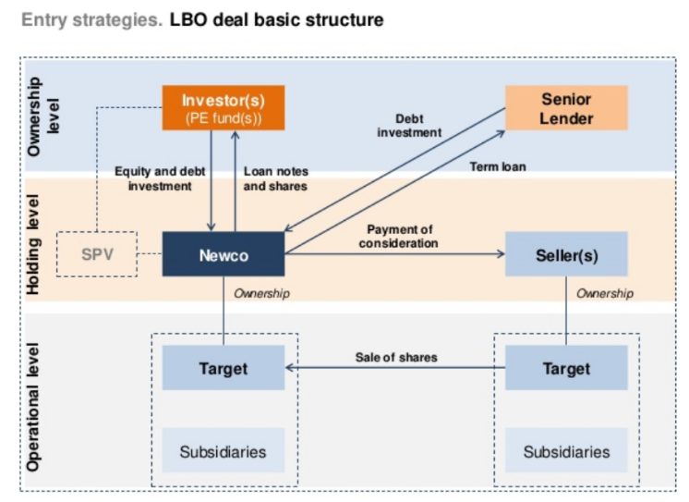
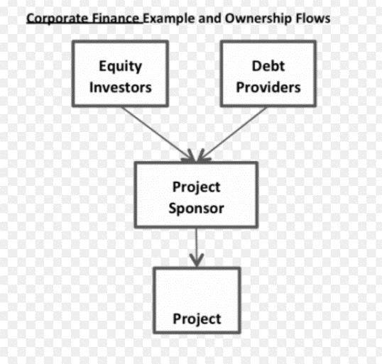
Initial Coins Offering: legal considerations
Legal corporate structure of token sales: benchmark
Project Finance structure
A divergence that may disappear: the jurisdiction of incorporation
Why are ICO shells mostly incoporated in Caymans or BVI compare to financing operations shells in financial centers jurisdictions (Europe, USA, Hong Kong, etc.)?
LBO/Finance deals focus mainly on how to secure and organize the rights of project debtors
ICO are still mainly driven by tax saving considerations
However in case of a rise of Security Tokens Offerings (STO), the tax considerations would not be sufficient
In structured finance deals, the investors (in debt + in equity) will be reimbursed / interested with the Cash Flows generated by the acquired or developed Operational Entity (Target or Project), as dividends or any other form, received by the Shell Entity (special purpose vehicle / holding) – those are the “Rolls Royce” of legal structures (expensives: for large ICO fundraising targets).

Slide 33



Initial Coins Offering: a strategic perspective
ICO issuers: a wider adoption by traditional business with the emergence “Tokenized business offerings”
If the traditional ICO model, of which Ethereum is by far the most successful, is for traditional startups, a TBO is a token sale initiated by an existing firms entering the ICO market, with tokenization of existing businesses (prof. Nicholas Krapels)
Company has an existing business, revenue stream and customer basis
create a tokenized ecosystem based around an existing platform solution, with an easily verifiable utility token that unlocks features of the platform: have real reasons for incorporating blockchain technology into their existing platform business.
Already 15% of 2018 ICO projects where TBO, which indicates interest from representatives of real business in the tokenization of their companies
2 of the top 4 most successful crypto capital raises in 2018 so far were TBO’s - Telegram (TON) and Huobi Token (HT) – Cf.table
Other examples: VIVOplay, Telegram, or firms selling goods & products launching Decentralized e-commerce platforms
TBOs evolve the Blockchain fundraising model

Slide 34
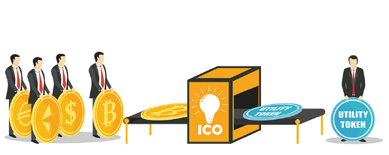


Initial Coins Offering: a strategic perspective
ICO products: 2017 and 2018 as the rise of Utility Tokens
Presumably, most tokens are securities since the majority of ICO participants view crowdsales as investment opportunities.
However, if a token does not meet the three requirements of the Howey test, it may fall under the classification of a “utility token”.
Utility tokens, which may also be called app coins or app tokens, provide users with access to a product or service.
For example, Filecoin - which raised an ICO-record $257 million - plans to provide a decentralized cloud storage service that will take advantage of unused computer hard drive space.
ICO contributors received tokens that they will be able to use to purchase storage space from Filecoin once the service has launched.
Since total supply is fixed, utility tokens may appreciate over time if demand for the product or service increases.
However, investors should be wary of startups that describe their token as a utility or app coin but also market it as an investment because it is likely that regulators will consider the asset a security.
It is important to note that “utility token” is an organizational distinction–not a legal one. The SEC has not given official guidance on utility tokens, so the industry does not with certainty whether they are subject to securities regulations.

Slide 35


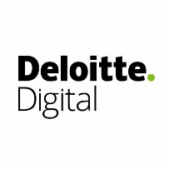


Initial Coins Offering: a strategic perspective
ICO advisors: traditional business advisors are entering ICO scene
As ICO fundraising is becoming mainstream, traditionnal businesses advisors are entering on the scene
Accounting firms Big 4 are advising on ICO deals: tax, legal, accounting (due diligences)
PWC, EY, Deloitte, KPMG all have a Tax ICO Advisory practice within their Financial Advisory Practice
This practice is added to the Consulting one, focus on blockchain uses cases / implementation (potentially post ICO)
Traditional top Business Law firms have created an ICO practice
Magic circle Law firms are all on the market: A&O, Linklaters, Clifford Chance…
Top Strategy Consulting firms are helping ICO issuers to implement blockchain solutions for digitalization/tokenisation of their business (development of the « Post-ICO » phase)
McKinsey, BCG, Bain, others
Some new consulting firms are focused only on blockchain
Example: Infosys

Slide 36

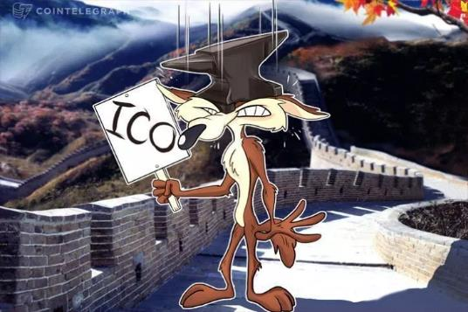

Initial Coins Offering: a strategic perspective
ICOs today: Problem and limits of ICOs
In December 2017, EY analyzedthe top ICOs that represented 87% ICO funding in 2017. In that report, we found high risks of fraud, theft and major problems with the accuracy of representations made by start-ups seeking funding
The performance of ICOs from The Class of 2017 did little to inspire confidence
86% are now below their listing price; 30% have lost substantially all value
Of the ICO start-ups we looked at from The Class of 2017, only 29% (25) have working products or prototypes, up by just 13% from the end of last year
Of those 25, seven companies accept payment in both traditional fiat currency (dollars) as well as ICO tokens, a decision that reduces the value of the tokens to the holders
The majority of ICOs are solving real-world problems with the use of blockchain technology. But not all of them require a coin or token to do this.
That’s because the applications of blockchain technology and smart contracts can often achieve the same results without the coin/token
Their technology is needed in the market but a coin/token may not always be required
Ethereum remain the industry’s main platform

Slide 37
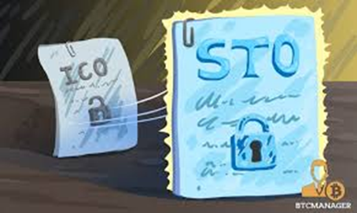


Initial Coins Offering: a strategic perspective
ICOs today: Problem and limits of ICOs
The majority of ICOs are solving real-world problems with the use of blockchain technology. But not all of them require a coin or token to do this.
That’s because the applications of blockchain technology and smart contracts can often achieve the same results without the coin/token
Most ICOs have become a simple case of solving the right problem with the wrong business model.
Their technology is needed in the market but a coin/token may not always be required
The crypto whales became aware of this, believing that some ICOs should ‘drop the ICO’ and become a ‘blockchain-based company’ instead.
“Security token offering” (STO) or “Initial exchange offerings (IEOs) may in the near future, serve as a model that could soon replace ICOs by listing projects directly on exchanges - without them necessarily needing to go through an ICO”
To maintain themselves as a true fundraising method, ICO will have to evolve and transform

Slide 38
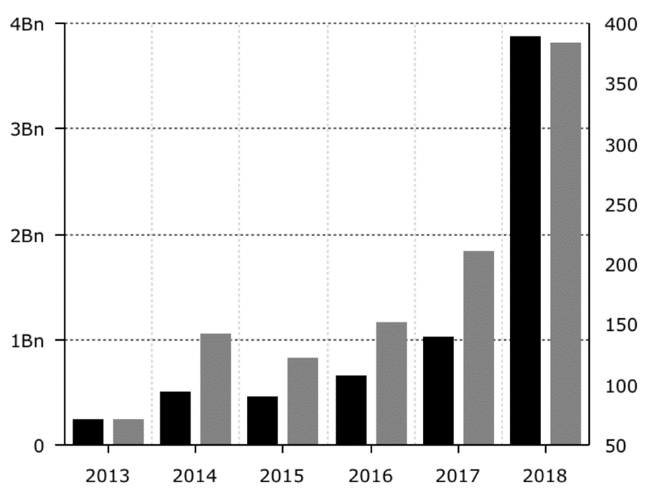


Initial Coins Offering: a strategic perspective
ICO investors: despite the contraction of the ICO market, traditional VC are still investing big on blockchain
Appart from ICO, VC funding keeps increasing in the Blockchain space
Venture Capital Investment in Blockchain and Crypto Up 280% in 2018
Traditional” venture capital (VC) investment in blockchain and crypto firms has almost tripled in the first three quarters of 2018, according to a new Diar report published September 30
The outlier was the DFINITY token, which raised a combined $163 million from VC investors Andreessen Horowitz, Hashed, and Polychain Capital
Diar reports that close to 2,000 investors have closed deals with at least one blockchain firm this year
U.S.-based investors representing the lion’s share at 79 percent, followed by 12 percent from China, and 2 percent from South Korea and Singapore respectively
VC investment and deal count in blockchain and crypto-related firms, 2013-18
Source: Diar
Capital invested
Deal count

Slide 39
Appendix Slides / Backups

Slide 40


Initial Coins Offering: a strategic perspective
ICO underlying technology: Blockchain, benefits & limits
Blockchain technology benefits
The need for a robust system to govern trustless transactions is the premier reason to utilize blockchain technology.
Two unknown parties can interact in a predetermined way (governed by a smart contract) and exchange only the data required to complete their transaction.
On public blockchains, contract code can be audited and verified by any user.
Trust
Blockchain Technology enables a variety of new use cases with benefits such as increased trust and enhanced security.
Security
Distributed blockchain systems are inherently secure.
Redundancy of systems running the same code prevents against attack.
Immutability
Once added to the blockchain, it is impossible for data to be corrupted or overwritten.
Decentralized systems are more resilient against attacks such as DDoS.
Application layers can operate without a central authority, enabling data and value to remain with users of the network.
Remove third party fees from transactions.
Decentralization

Slide 41








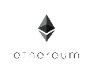

Initial Coins Offering: a strategic perspective
ICO underlying technology: Blockchain, benefits & limits
Platform Enablement
Foundational layers being built on the blockchain
Self-Sovereign Identity
Ownership of your identity on the blockchain for verifiable and transferable ownership of personal data.
Permissioned Blockchains
Other non-public or semi-public blockchains can be used for enterprise-grade transaction recording; compare to public ledgers such as Ethereum.
Decentralized Computation & Storage
Share computational resources across geographies with untrusted third parties. Store files across multiple locations for redundancy and faster access.
Peer-to-peer sharing without intermediaries
Removing the need for a trusted third party reduces the requirements that large centralized parties – such as Uber and AirBnB – arbitrate transactions.
Tokenization through Ethereum
Existing enterprises can create utility tokens and assets to provide fractional ownership of aspects within their network

Slide 42







Initial Coins Offering: a strategic perspective
ICO underlying technology: Blockchain, benefits & limits
Industry Verticals
A (brief) overview of industries where blockchain technologies enable promising use cases.
Gaming & e-Sports
Virtual Assets
Free Speech
Journalism
Tradeable in-game items
Verifiable Sources
Use of ERC-721 standards creates the opportunity for unique items that can be bought and sold in virtual environments, with ownership verified on the blockchain.
Journalists can publish to these platforms, ensure copyright control, safety in regimes where free speech is repressed, and users can verify origin of content.
Supply Chain
Unlock Capital
Provenance of Goods
Payment Processing
Safety and CSR
Increase Throughput
Supply chain verification and tracking of goods; blockchain technology can quickly verify sources of fish in sushi, ensure conflict minerals are not used in finished goods, and trace the origin of foodborne illnesses to contain outbreaks.
For items such as trade financing and payable reconciliation, blockchain can execute pre-determined payment terms and even enable such activities as daily payments for employees or vendors.

Slide 43


Initial Coins Offering: a strategic perspective
ICO underlying technology: Blockchain, benefits & limits
Today more than 200 crypto-exchanges offer their services and this number is constantly growing.
Over the past 8 years about 31 crypto exchanges have been hacked and more than a 1 billion dollars ($ 1.3 bn) stolen.
Some of the crypto exchanges learned from their mistakes and managed to recover, the others went bankrupt.
Blockchain technology risks and limitations
Cryptocurrencies
exchanges security
Despite its benefits, Blockchain Technology is facing key challenges and risks to be addressed in order achieve widespread adoption
Vulnerabilities can sit in the smart contract source code. Smart contract development environments are highly volatile and new bugs can result in various security dangers for the blockchain platform.
A current best practice is to perform smart contracts security audits.
Smart contracts
security
Current blockchains technical problem range from operational delays on a distributed ledger network to slow transaction speed are the main reasons for many players to avoid considering blockchain as a technology that can be applied in “large-scale applications.”
Scalability
and complexity
Lack of interoperability prevents blockchain-related firms from interact and collaborate with each other: there are over 6,500 active blockchain projects on GitHub, with most of them based on different protocols, consensuses, privacy measures, as well as written in different coding languages.
.
Standardization
and regulation

Slide 44
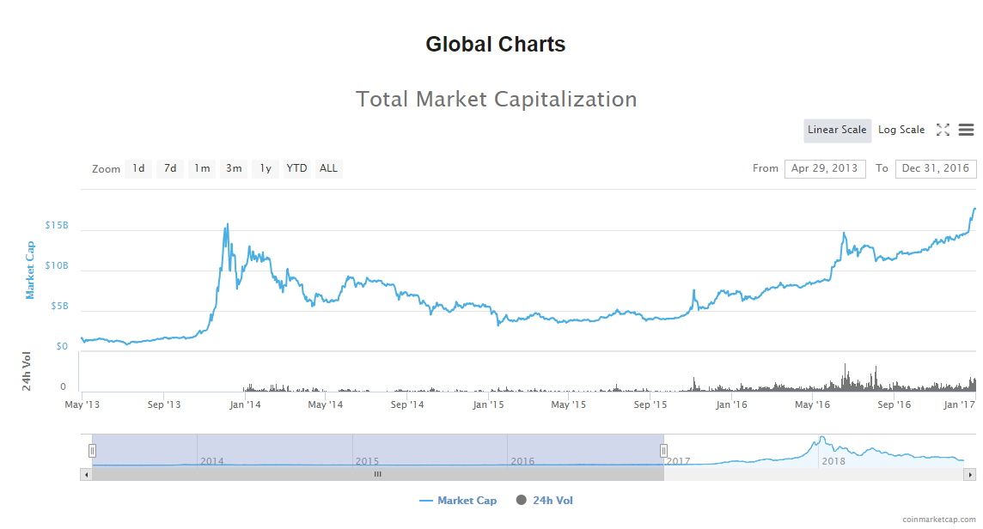
A brief history of crypto markets over time shows a growing and volatile asset class emerging in the years following the introduction of Bitcoin, Ethereum, and other cryptocurrencies.
*
There are many, many, more, Blockchain companies focused on applications ranging from identity management, cloud storage, public voting, sharing economy, distributed market-making, and banking to name a few.
Notes:
DLT

Slide 45
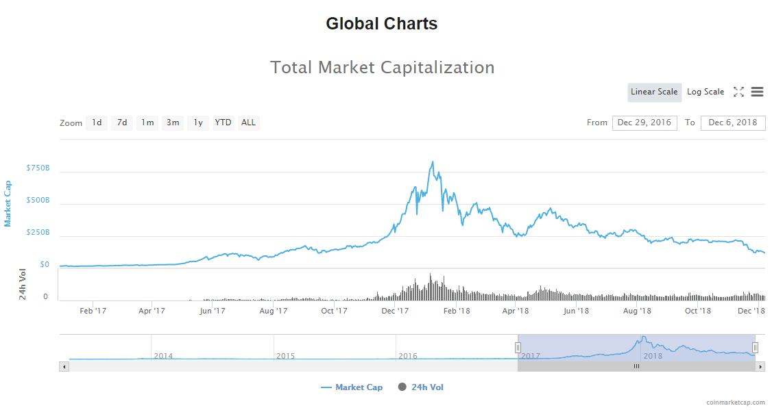
The last two years have produced massive investment gains in the space, driving the total market cap up to 830B USD, and in less than a year has dropped by nearly 90% to about 120B USD today*
*
There are many, many, more, Blockchain companies focused on applications ranging from identity management, cloud storage, public voting, sharing economy, distributed market-making, and banking to name a few.
*As of December 6th, 2018
Notes:
DLT

Slide 46
Two Key Components to Blockchain
Decentralized Data Storage
Cryptographic Security
Data is stored in multiple places
Each is entry is chained to the next
Built on public-key infrastructure
Strength can be varied according to use
Reduced damage caused by a data breach
Distributed ledgers assure legitimacy throughout the network—creating a fraudulent transaction requires inserting false information in many many different places simultaneously
Security and privacy of data is backed by cryptography, making fraudulent transactions difficult

Slide 47
These Components Allows For…
Process Automation
Value Transfer
Allows for the creation of Smart Contracts
Program modular business rules
These programs are now built into the database
Can transfer digital values...
But this is not necessary for its use
Creates digital representations of assets and allows for transacting with these assets
Blockchain allows for digital value transfer by creating trust even in a trustless ecosystem. Value can be digitally transacted, whether it be money, asset ownership, or secure information.
Smart contracts, digitally coded self-executing contracts can automate processes and allow for the creation of many additional applications on the Blockchain.

Slide 48
What is the difference between a Blockchain (decentralized, distributed) and a traditional (centralized) database?

Slide 49

Blockchain vs Database
Blockchains aren’t databases
 | Blockchain | Database
Security | Much More Secure | Not as Secure
Robustness | No Single Point of Failure | Has Single Points of Failure
Network | Peer to Peer | Centralized
Energy Consumption | High | Fairly Efficient
Speed | Slow, ~ few mins/transaction | Fast, ~400ms / transaction
Network Capability | Low, best for small amounts of data | High
Notes:
Very simplified level

Slide 50
A selection of companies currently implementing the technology
Scaling, Stability, and Trust
These are the reasons to pursue a distributed Blockchain network (not because it is an easy thing to do from a software standpoint, or because it is an effective database).
Blockchain distributed networks can create something that can scale massively while being extremely stable. It is becoming more and more difficult to protect centralized databases, and scaling and stability are becoming increasingly bigger concerns. With Blockchain, the network can create trust between parties, and scale to great lengths without any single points of failure.

Slide 51
FinTech Week In Hong Kong Sharing
A synopsis from our volunteers

Slide 52
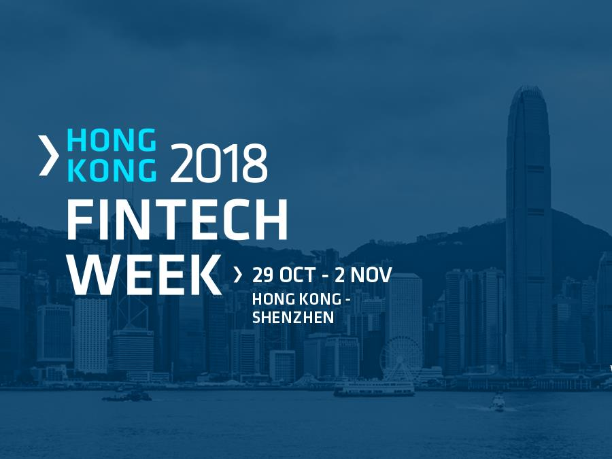
HK FinTech Week Sharing

Slide 53
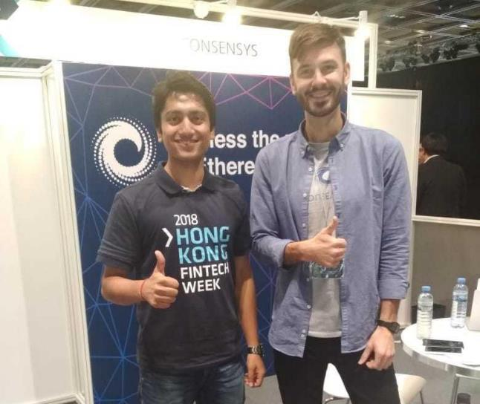

Our Presence at HK FinTech Week 2018 !

Slide 54
HK FinTech Ecosystem 2018

Slide 55
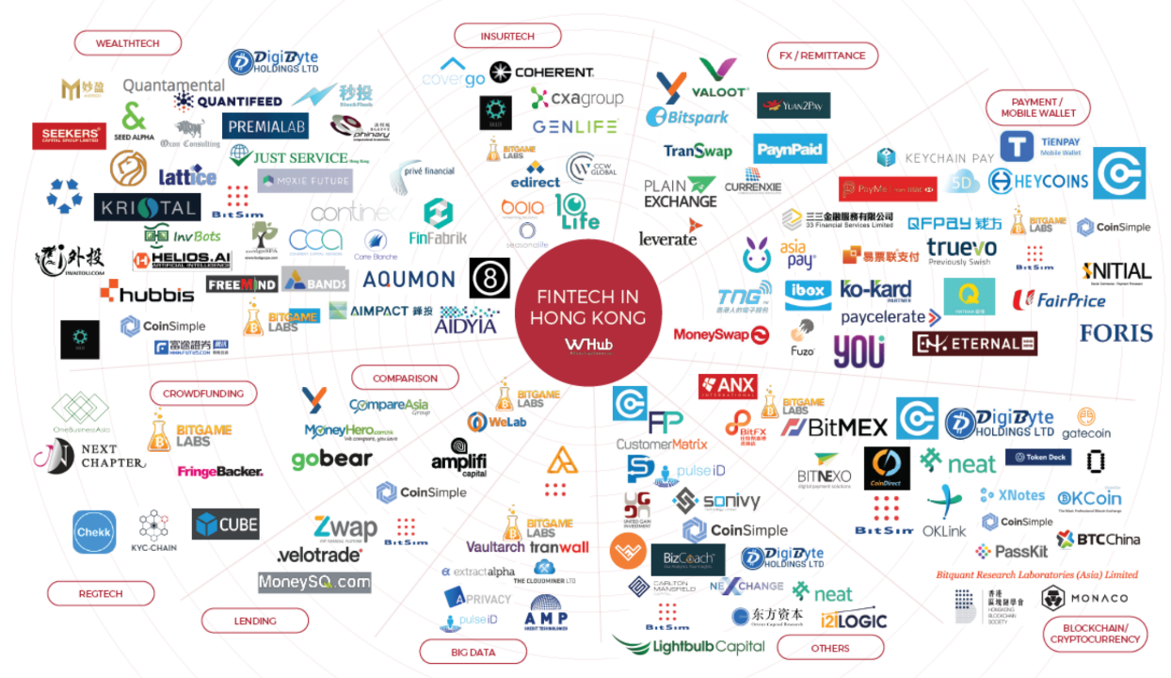
Notable Startups in the HK FinTech Ecosystem

Slide 56
Key Focus Areas and Topics
Open API (Application Programming Interface) for Banking Sector
Payments/ Mobile Wallets
Big Data/AI/RegTech
Rise of virtual banks and Neo banks (WeBank, Neat)
HK ecosystem:
Mynt and Ant Financial
TNG FinTech Group
KYC/ AML, particular SME space

Slide 57
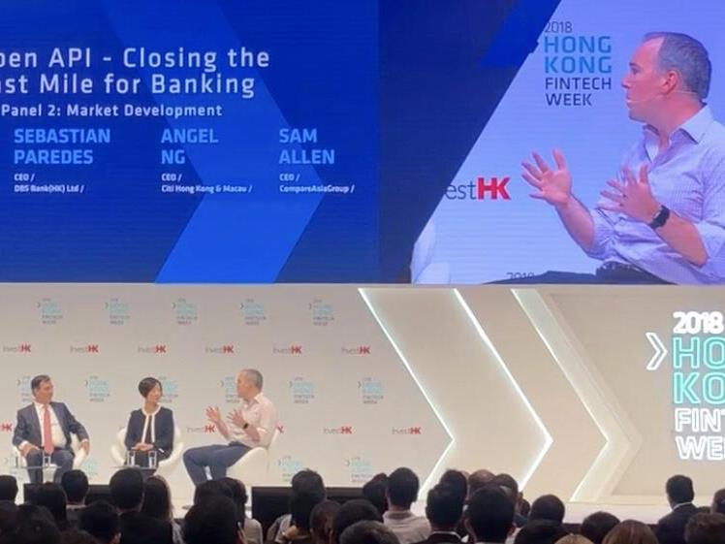
Open APIs in HK

Slide 58
Open API ( Application Program Interface)
Open API enables bank customers and businesses, to use third-party providers to manage their finances.
E.g. you may use Facebook or Google to pay your bills, making P2P transfers and analyse your spending, while still having your money safely placed in your current bank account.
Banks, however, are obligated to provide these third-party providers access to their customers’ accounts through open APIs.
This will enable third-parties to build financial services on top of banks’ data and infrastructure.
Europe PSD2 – Jan 2018
(Revised Payment Service Directive)
HKMA Open API – mid 2019
Australia – Mid 2021

Slide 59
Virtual Banks in HK

Slide 60
Virtual Banking vs Neo Banking
Co-Founder and Chief Strategy Innovation officer of NeoBank Xinja shared that:
Neo bank is not digitised bank, not white label led; not legacy bank; not digital front end with an old bank. Not designed to dress up old business model => tech alone is not enough
Neo bank is mobile/instant/integrated/ethical/borderless.
Neo-banking emerged about 5 years ago in the UK through FinTech players such as Revolut and Atom Bank.
Neo Banks are reinventing the practices and processes associated with traditional banking.
They don't have their own bank license generally, but use partners to offer bank-licensed services. Apps that facilitate the administration of accounts and credit cards.
What about Virtual Banking?
Virtual Banks are banks without branches. Example – Marcus by Goldman Sachs.

Slide 61
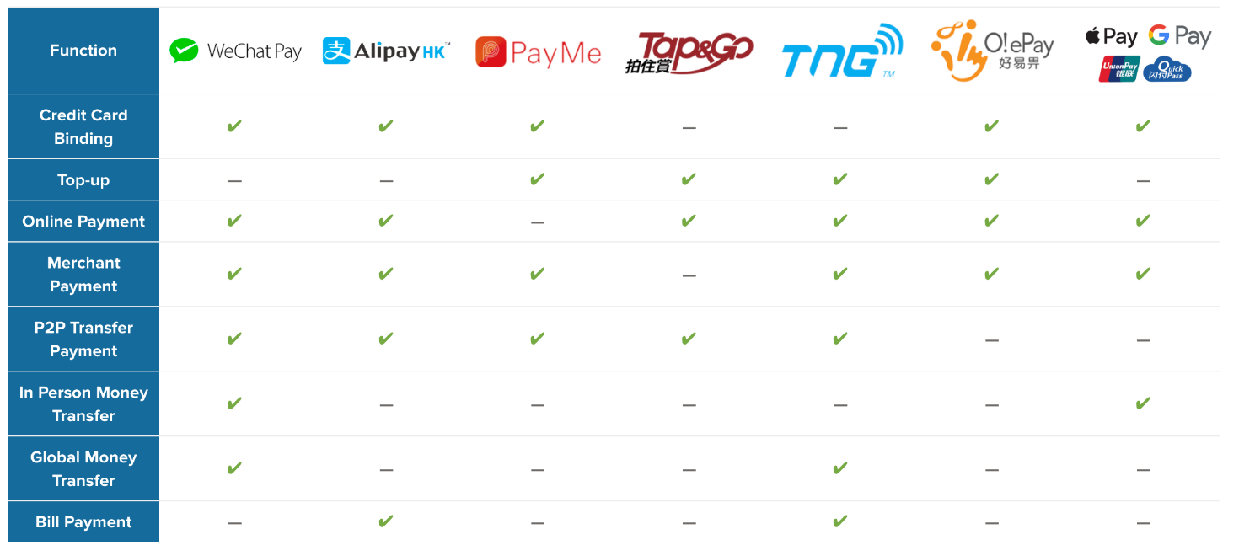
Digital Payments/ E-Wallets in HK

Slide 62
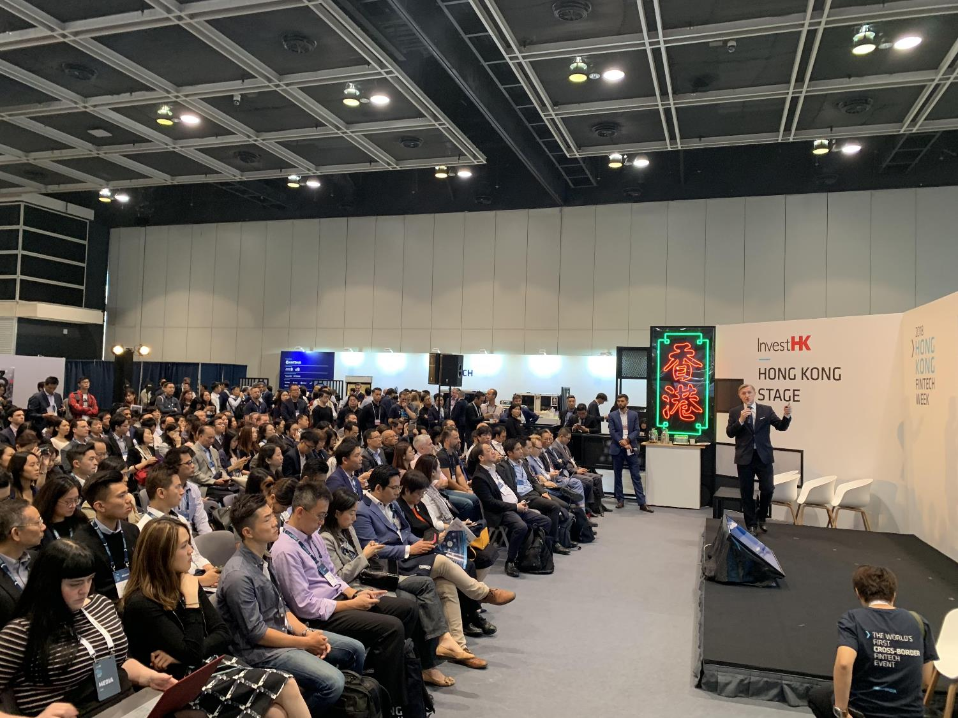
Big Data/AI/ RegTech in HK

Slide 63
AI in FinTech Market

Slide 64
RegTech

Slide 65
FinTech vs TechFin
The difference between Fintech and TechFin is based on the origin of the underlying organization.
Fintech usually refers to an organization where financial services are delivered through a better experience using digital technologies to reduce costs, increase revenue and remove friction.
E.g. non-traditional financial offerings such as PayPal, Zelle and Venmo in the U.S. and digital-only Starling Bank and Revolut in the U.K.
Techfin usually refers to technology firms entering into the financial field as they find a better way to deliver financial products as aprt of a broader offering of services.
E.g. Google, Amazon, Facebook and Apple in the U.S. and Baidu, Alibaba & Tencent in China.
HKMA has received 29 applications for virtual banking licenses
Including Tech giant from China
FinTech company such as TNG
Traditional banks

